Slide 1

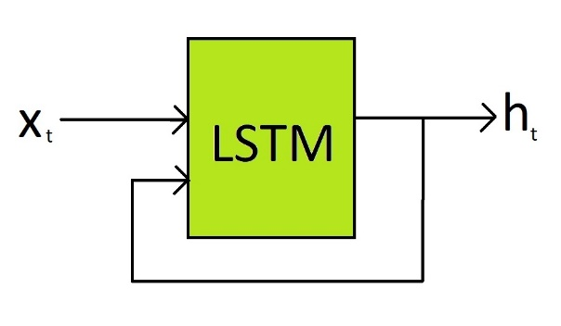
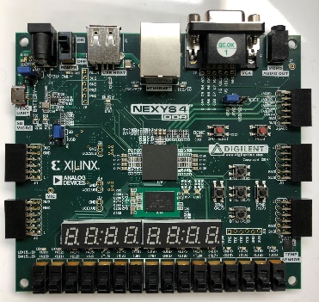
Creating a Pipelined Long Short Term Memory Hardware Processor
Accelerating Ai
Tom Dale
Image:http://www.akite.net/en/news/intelli-tail-artificial-intelligence-for-retail
Notes:
Break this down:
Long short term memory network
Why hardware
What is pipelined

Slide 2
Pipelined Long Short Term Memory Hardware Processor

Slide 3
Artificial Intelligence (Ai)
Artificial Neural Network (ANN)
Recurrent Neural Network (RNN)
Convolutional Neural Networks(CNN)
Long Short Term Memory Network (LSTM)
Notes:
Landscape of Ai

Slide 4
Convolutional Neural Network
Recurrent Neural Network
Input
Output
Input
Output
Notes:
Convolutional: solves problems like is this an image of a cat
Recurrent neural network. Solves dynamic problems like is this a video of a cat. Especially good at language processing

Slide 5
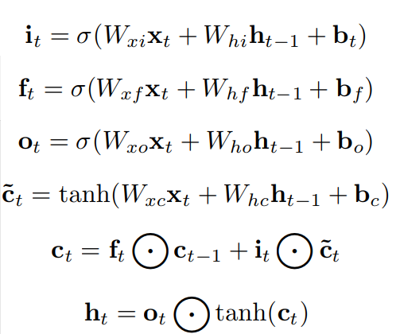
LSTM: a better RNN
Vanilla RNNs have a problem-> error propagation
Long Short Term Memory(LSTM) networks know when to forget->no error propagation [2]
Notes:
Talk about how LSTM networks avoid error by forgetting bad information.
Input
Forget
Proposed Output
Memory Candidate
Memory Save
Final Output

Slide 6

Pipelined Long Short Term Memory Hardware Processor

Slide 7
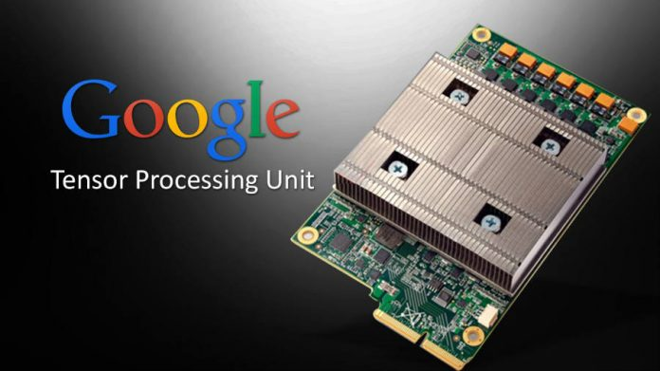

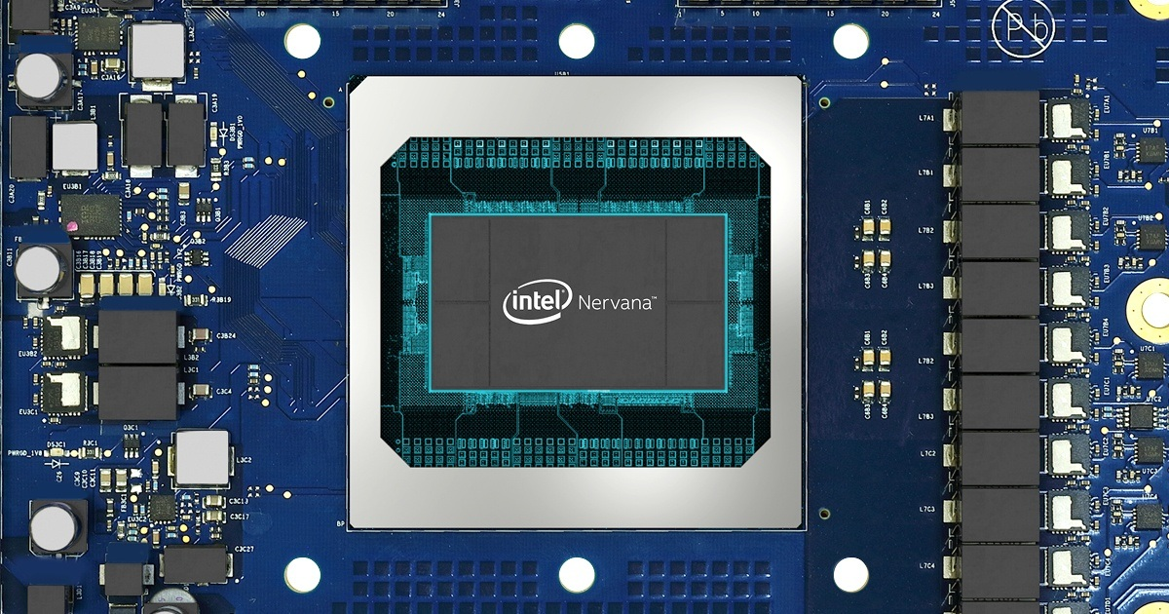
The Future of Computing:
Neural Network Specific Hardware
Google Tensor Processing Unit
Nvidia Ai Engine
Intel Nervana Chip
Image: https://cloud.google.com/blog/products/gcp/an-in-depth-look-at-googles-first-tensor-processing-unit-tpu
Image:https://www.xilinx.com/support/documentation/white_papers/wp505-versal-acap.pdf
Image: https://ai.intel.com/
Notes:
Artificial Intelligence Engines are domain specific computer architectures for running Nueral network applications
Also called:
Tensor processing unit,
Hardware Neural Network,
Neural Network Accelerator,
Neural Network Processing Unit,
Neural Processor

Slide 8

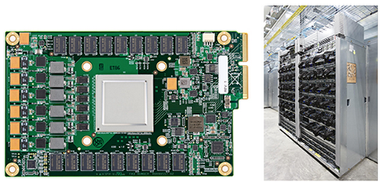


Example: Google maps
TPU Server Image: Google/ai/tpu.com
Google Maps Icon: Wikipedia/googlemaps.com

Slide 9
Pipelined Long Short Term Memory Hardware Processor

Slide 10
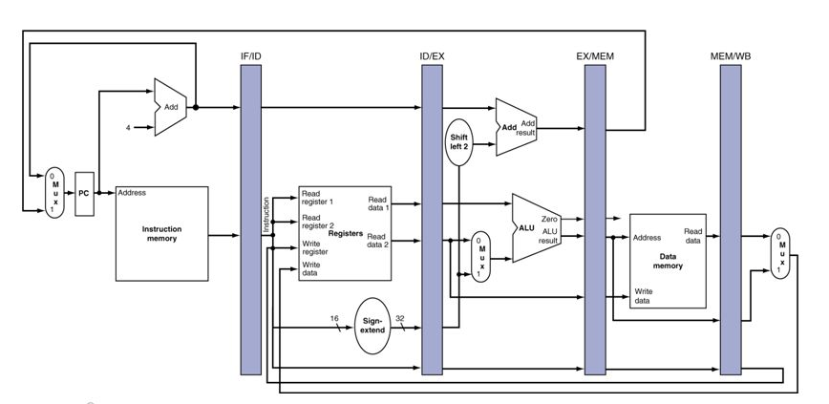
Types of Architecture: Single Cycle vs. Pipelined
T=0
Single Cycle Timing
Process 1
Process 2
Process 3
T=0
Pipelined Timing
Process 1
Common Pipelined CPU Design:
Process 2
Figure: https://cs.nyu.edu/courses/fall08/V22.0436-001/lecture18.html
Process 3
Notes:
Describe how single and pipelined architectures reuse processor components.

Slide 11
Pipelined Long Short Term Memory Hardware Processor

Slide 12
Industry Has Focused on CNN Hardware
Google reports that over a third of its neural network applications use Recurrent Neural Networks [1]
Running Neural Networks on most convolutional neural network processors
require unfolding
RNN
Unfolded RNN: INNEFFICIENT
…
Input
Output
Input
Output
Notes:
Currently to run CNNs on hardware you need to unroll them
Unrolling requires multiplying the number of layers required by the amount of iterations needed

Slide 13
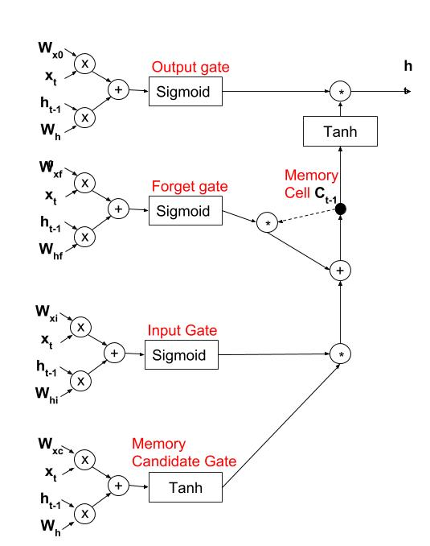
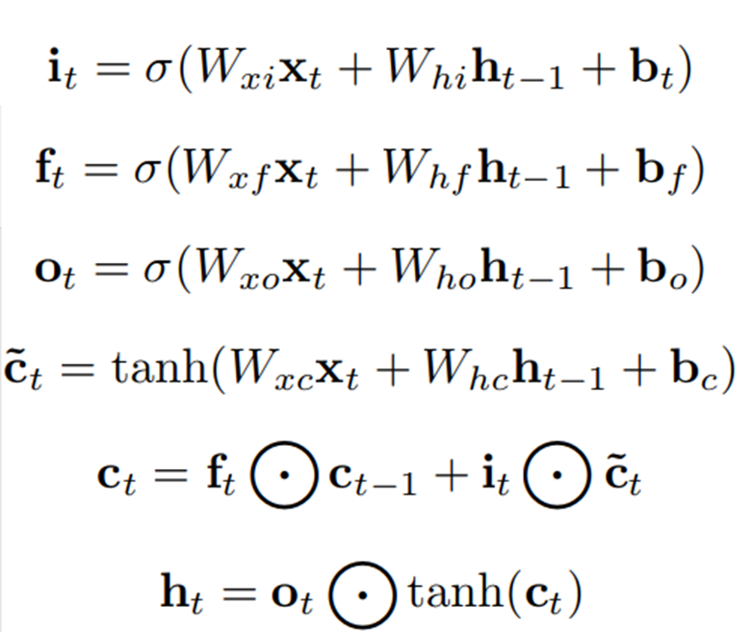
Single cycle Model LSTM Processor
Notes:
This was the single cycle model I looked at. It carries out the data flow shown in the LSTM equations

Slide 14
LSTM Network Processors need more work…
Current best known LSTM processor: “ESE” can run 282 Giga operations-per-second (GOPS)[3].
Not fast enough for production when Google’s TPU achieves 92,000 GOPS[1]
How?
Notes:
Current research at Stanford has achieved great things, but still, googles CNN processor is over 100X faster.
Where can we find speedup

Slide 15
Notes:
I noticed that there are 5 overlapping sections in the traditional LSTM processor archecture,
What if I reuse a common processing space by designing a pipelined architecture

Slide 16
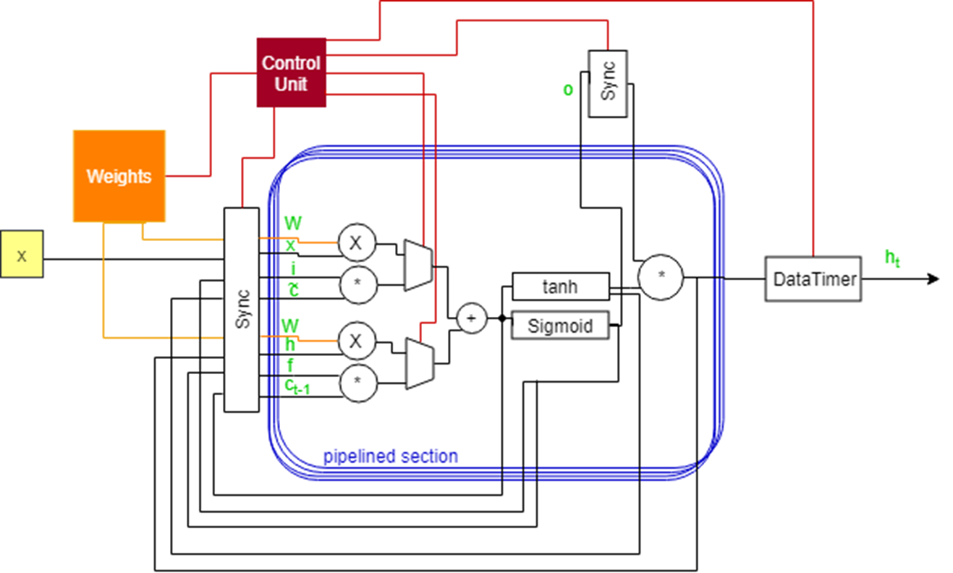
Pipelined Model

Slide 17
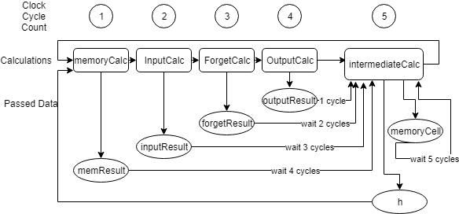
Pipelined Data Timing
Notes:
Talk about why we need data timing in pipelined but not in single cycle. Its important that we have the data at the time we want to.
Takes 5 times the number of clock cycles. But less to do every cycle so theoretically we should get a 5 times faster clock

Slide 18

Implementation:
Used a Field Programmable Gate Array (FPGA) to build designs
Programmed using VHDL hardware description language.
Tested using Vivado XDE toolkit
Abstracted I/O and nonlinear functions
NEXYS 4 DDR FPGA used
Notes:
Implemented on this FPGA
Explain VHDL a hardware descriptive language. Like programming but its actually telling where physical wires and transistors need to be placed
Tested using vivado. Talk about testing methods
I implemented a data path model of both versions to analyse size and speed. No I/O or nonlinear functions added for development times sake. Should be accurate representations of size

Slide 19
Results

Slide 20
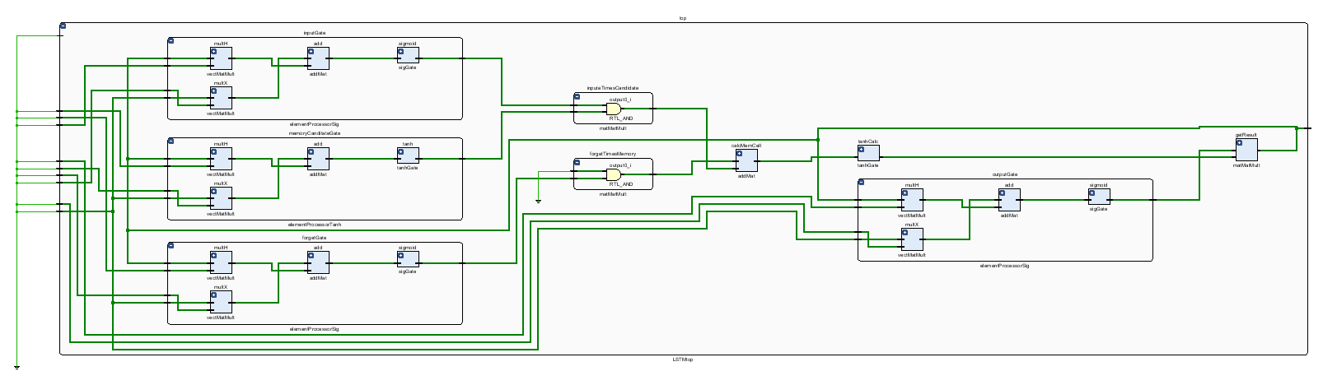
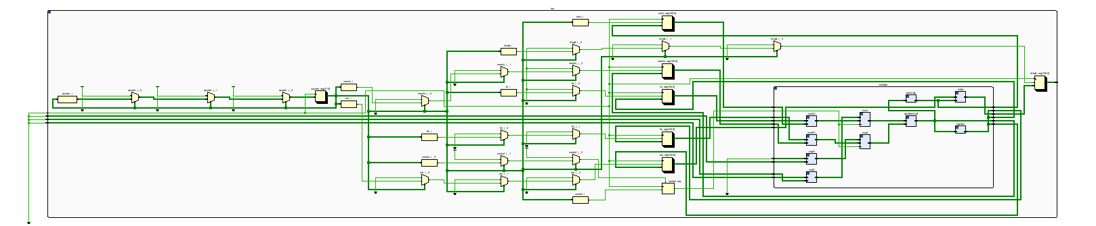
Size Comparisons:
Single Cycle Model: 1225 Logic Cells
Pipelined Model: 728 Logic Cells
Notes:
Abstract, vivado generations of the designs I build on both boards.
Yellow are data routing, blue are data processing. Pipelined requires more routing but less processing.
Pipelined model requires 59% the space. That means more data processing can be squeezed onto the chip
THIS IS REALLY GOOD

Slide 21
Problems!
Speed
Both clock Cycles measured at 100 MHz
NEXYS 4 DDR max clock cycle is 100 MHz
Power
Power: Single Cycle->41w Pipelined Model->48w
Abstraction of non linear functions and I/O design made power consumption data unreliable.

Slide 22
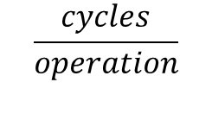
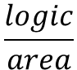
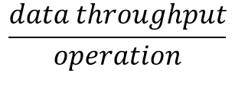
Future Study
Run implementation on FPGA board with faster clock cycle capabilities
Fully implement nonlinear functions and I/O connectivity
Use designs to actually process LSTM applications to prove functionality
59%
$$\frac{logic}{area}$$
169%
$$\frac{data throughput}{operation}$$
5X
$$\frac{cycles}{operation}$$
Pipelined model needs speeds at least 2.95X of the standard single
assuming power consumption is similar
Notes:
Because it take only 59% the space we can theoretically fit 169% the processing per operation. With the pipelined model requiring 5 cycles per operation this means that we need to find a 3X faster clock speed on the pipelined model to beat the current best single cycle models

Slide 23
[1] Jouppi, Norman P., et al. "In-datacenter performance analysis of a tensor processing unit." Computer Architecture (ISCA), 2017 ACM/IEEE 44th Annual International Symposium on. IEEE, 201
[2]Yoshua Bengio, Patrice Simard, and Paolo Frasconi. Learning long-term dependencies with gradient descent is difficult. IEEE transactions on neural networks, 5(2):157–166, 1994. 7.
[3] Song Han, Junlong Kang, Huizi Mao, Yiming Hu, Xin Li, Yubin Li, Dongliang Xie, Hong Luo, Song Yao, Yu Wang, et al. Ese: Efficient speech recognition engine with sparse lstm on fpga. In Proceedings of the 2017 ACM/SIGDA International Symposium on FieldProgrammable Gate Arrays, pages 75–84. ACM, 2017.

